Slide 1
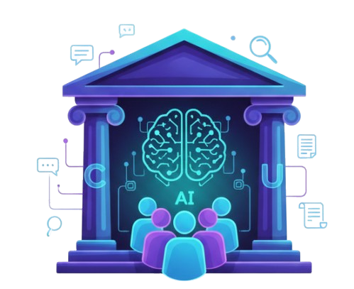

The AI-Powered Operating System for Democracy
Civic
Utopia
Project by : Adrian Tennant and Gary Bryan
Innovate Challenge Nov 2025
Your Voice. Your Vote. Your Vision.

Slide 2





Civic Utopia
Problem Statement
We identified three critical gaps in our community
Information Overload
Laws are written in legalese, not human language.
Disengagement
Citizens don't know who their leaders are or what they stand for.
Barriers to Action
Reporting a simple pothole feels like filing a tax return.

Slide 3
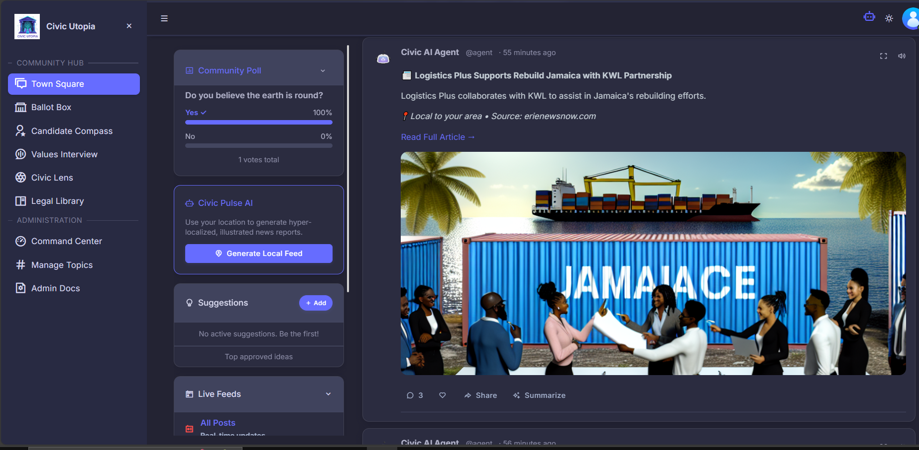




Civic Utopia
Solution Overview
Enters Civic
Utopia
Multi-agent system
Emowers Democracy
Civically Responsible
It combines a social feed, a legal library, and a civic toolkit into one cohesive experience.
It makes democracy Accessible, Understandable, and Actionable.
Gives you what to think without telling you how to think.

Slide 4
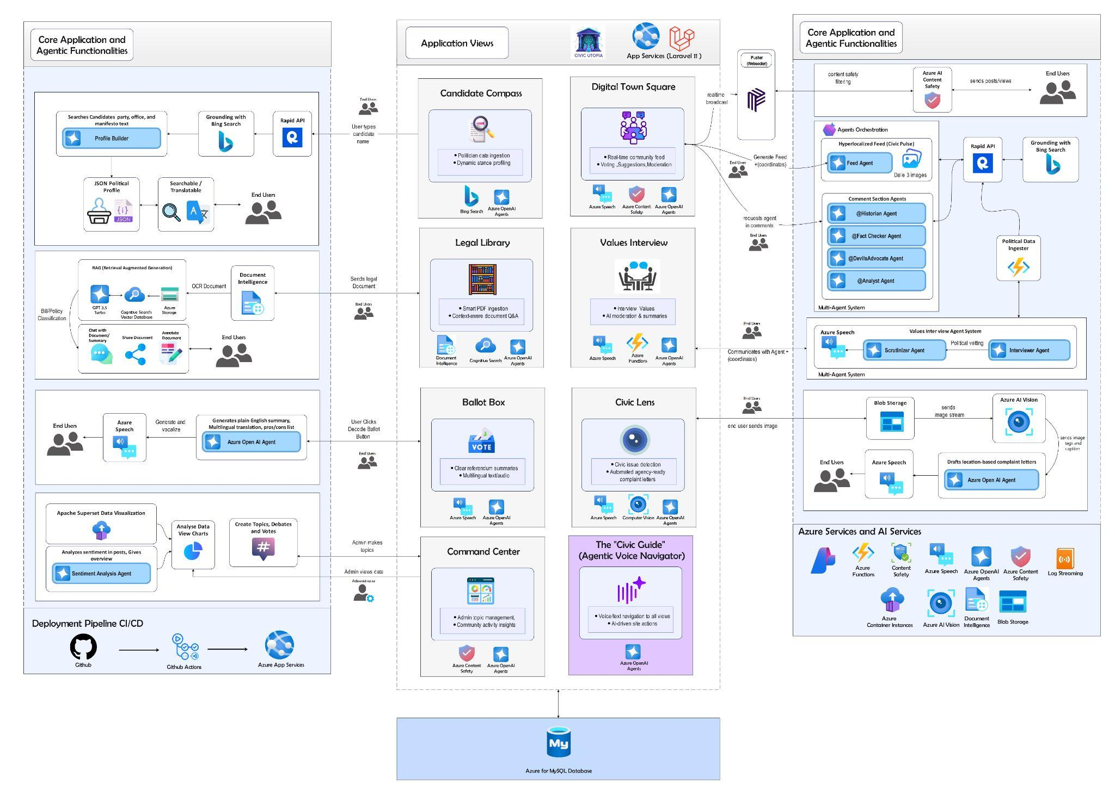
Civic Utopia
Architecture Diagram

Slide 5




Civic Utopia
App Features
Town Square
Local Feed
Civic Guide
Values Interview
Community heartbeat for debate, sharing, and connection.
Hyper-local news briefing via geolocation and Bing.
Hands-free platform navigation with Azure Speech for accessibility.
Smart AI chat that scales to your style and maps your politics.

Slide 6




Civic Utopia
App Features (cont’d)
Legal Library
Ballot Box
AI Council
Civic Lens
Azure AI transforms complex PDFs into documents you can query and annotate.
Legislation decoded into Plain English & Other Languages with instant voice playback.
AI agents intervene in comments to block misinformation and push conversation.
Turns user photos into formal complaints sent to government agencies.

Slide 7




Civic Utopia
Responsible AI
Safety & Moderation
Grounding & Reliability
Blocks hate, violence, and self-harm to keep the digital square constructive.
Agents use Bing and official PDFs, admitting gaps instead of hallucinating.
S
R
T
I
Radical Transparency
Inclusiveness by Design
Users are told when content is synthetic, and the rating loop ensures accountability.
We connect seniors, the visually impaired, and low-literacy groups across the digital divide.

Slide 8

Civic Utopia
Thank You
For Joining This Presentation

